Slide 1


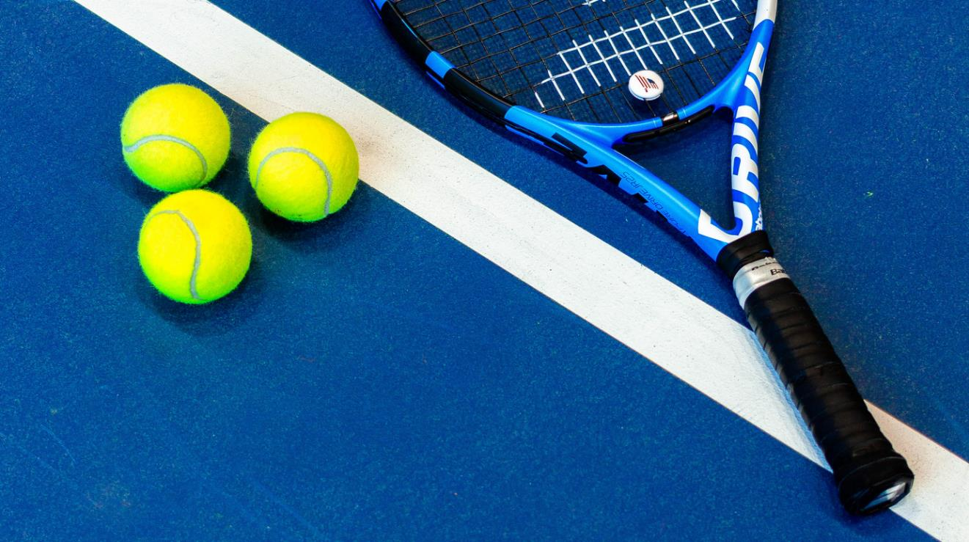
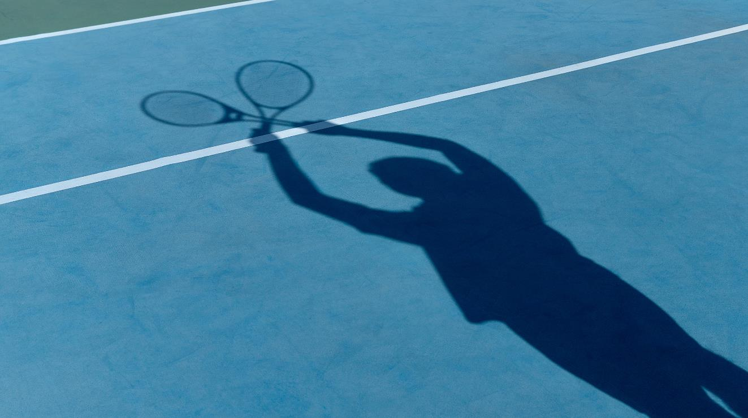
Group 12
presents
SOCIAL INDICATORS AND OLYMPICS
Under the Guidance of
Dr. Dootika Vats
Presented By:
Sujal Yadav
Vinay Chavan
Utkarsh Kesharwani
Jatavata Balakoti

Slide 2
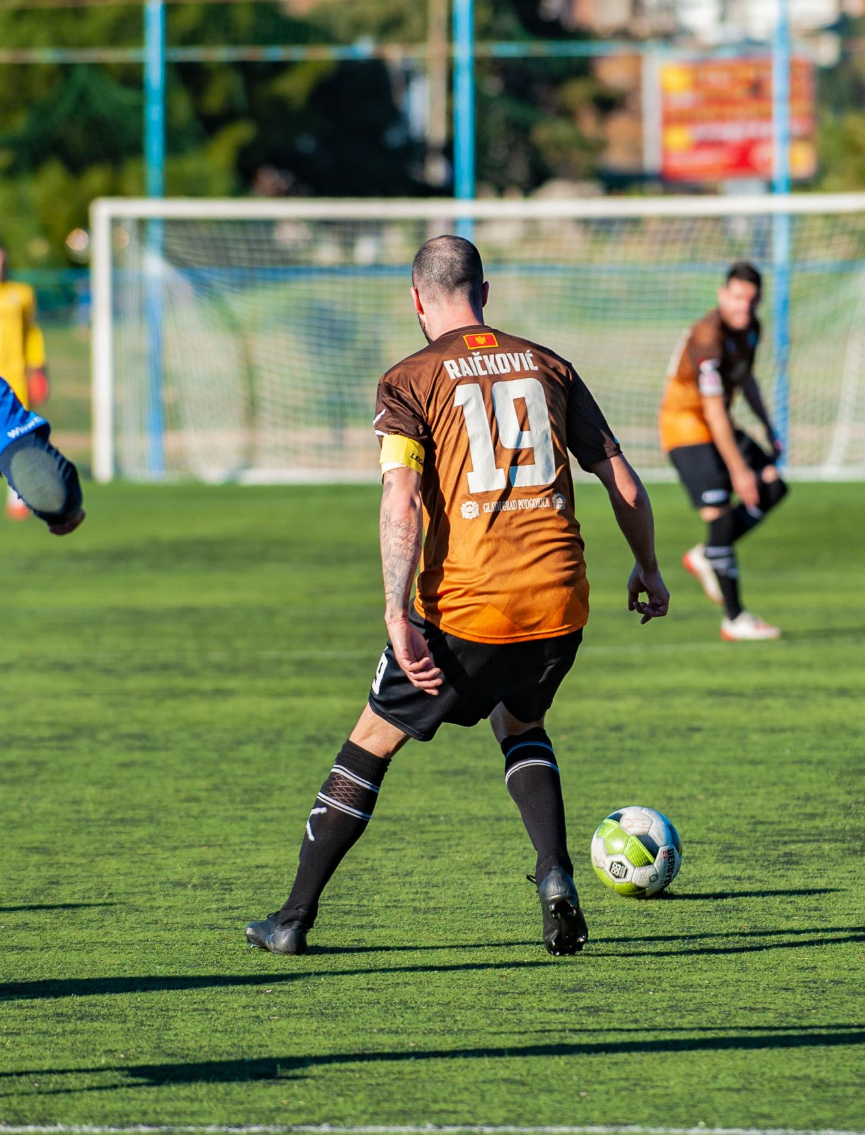



How Do Social Factors like GDP,Life expectancy,Sex ratio correlates with Olympic participation
Can We Uncover Hidden Patterns Using Our R skills to Explore Social Factors and Olympic participation?

Slide 3

What does this RShiny do?
Focus: Women-centered analysis of Olympic medals, GDP, and social indicators by country.
Scatter plots comparing medals with life expectancy and GDP.
Continent-based filter and color-coded data points.
Insights: Reveals connections between women's Olympic success and socio-economic factors.

Slide 4
Let's collect ingredients (data) from the market (websites).
GDP Data : https://en.wikipedia.org/wiki/List_of_countries_by_past_and_projected_GDP_(nominal),
Life Expectancy Data :
https://www.worldometers.info/demographics/life-expectancy/,
Sex Ratio Data :
https://en.wikipedia.org/wiki/List_of_sovereign_states_by_sex_ratio
Olympics Data :
https://raw.githubusercontent.com/VinayChavan2006/R-project/main/Data/datasets/olympicsDat.Rdata,
Continent Data :
https://statisticstimes.com/geography/countries-by-continents.php

Slide 5
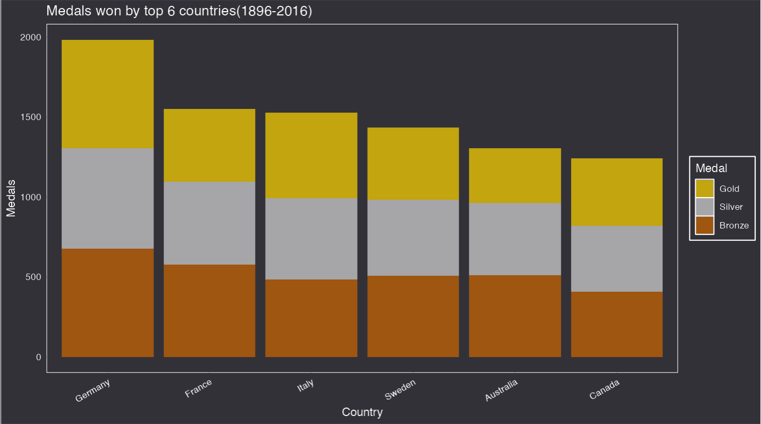
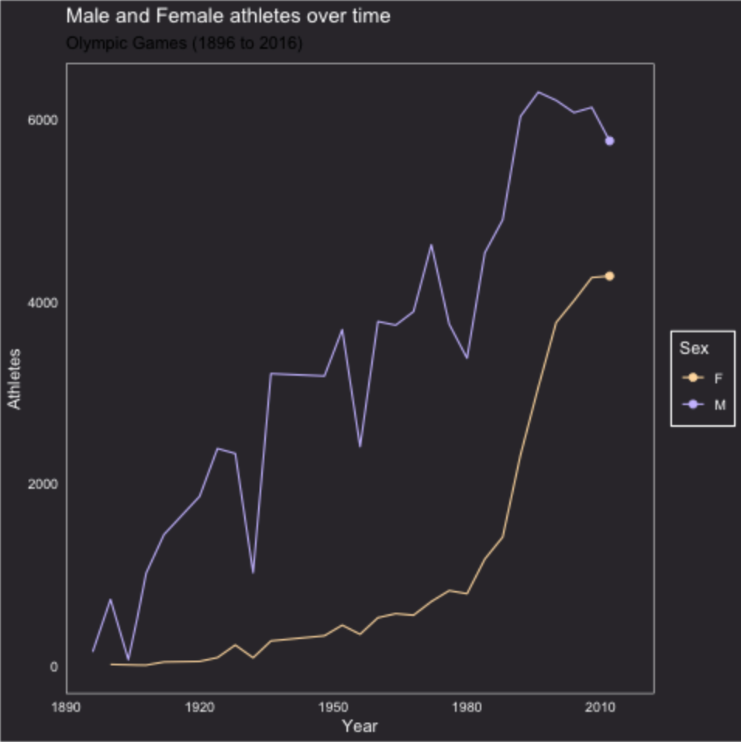
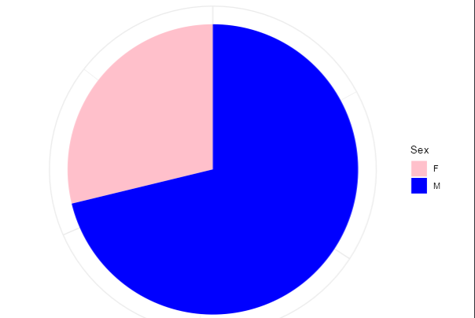

Slide 6
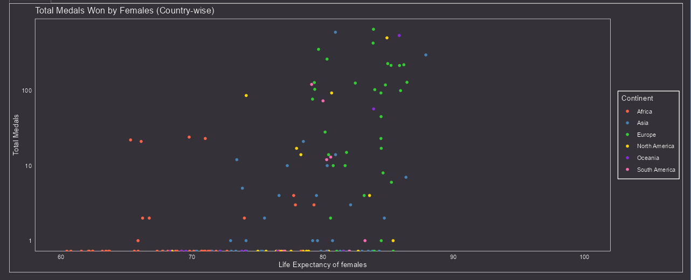

Slide 7
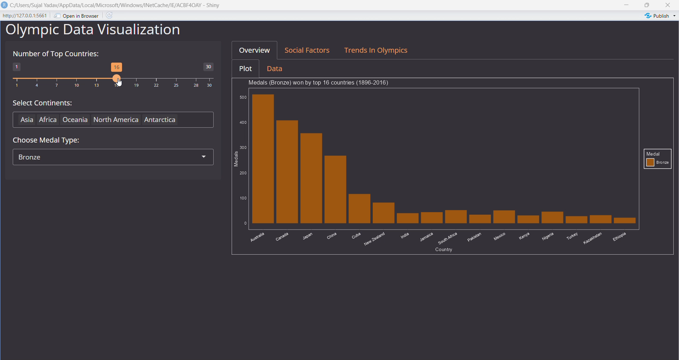
Representation speaks Louder Than Research

Slide 8


